Slide 1
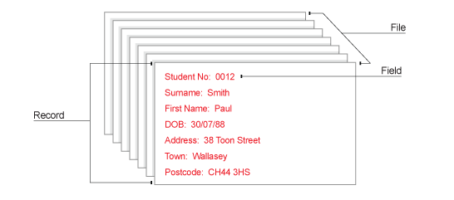
Database Basics

Slide 2
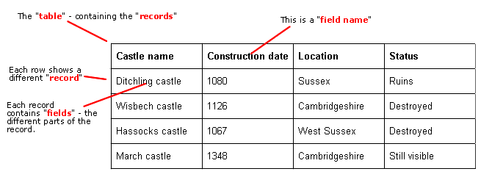
Databases
A database is a collection of related data stored in a logical and structured manner.

Slide 3
Database Components
File(table):
A collection of related records which contain the same type of information as all the other records
e.g. Information about ALL students in a class
Record:
All of the data relating to one item or “thing”.
e.g. All information about ONE student in the class
Field:
Stores one item of data in a record
e.g. a single characteristic about a student (date of birth, surname etc.)

Slide 4
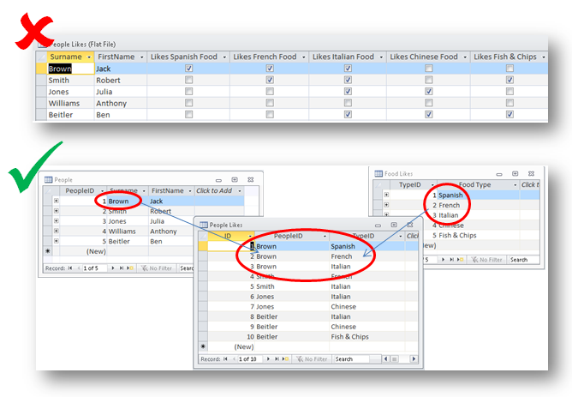
Database Types
Databases can be either flat file or relational.

Slide 5
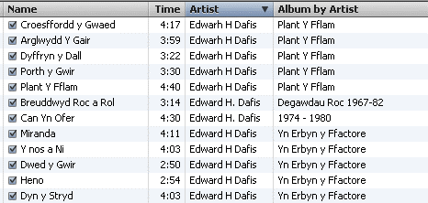
Flat File Databases
A flat file database usually only has one table (it may have more than one table, but with no links between them)

Slide 6
Flat File Databases
Advantages:
Easy to set up and understand – no specialist knowledge needed
Disadvantages:
May have redundant data
Potential duplication of data
Harder to update the data due to duplication
Records are not unique
Security is poor as if access is gained all data is readily available
Harder to perform complex queries

Slide 7
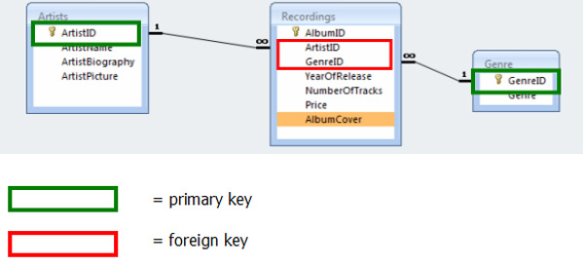
Relational Databases
A relational database has more than one table which are linked together by primary and foreign keys.

Slide 8
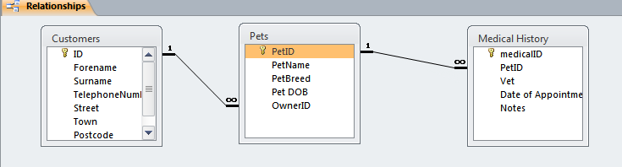
Primary and Foreign Keys
A primary key is used to uniquely identify a record
A foreign key is a primary key in one table which is used as an attribute in another table to provide a link between tables
Primary Key
Foreign Key

Slide 9
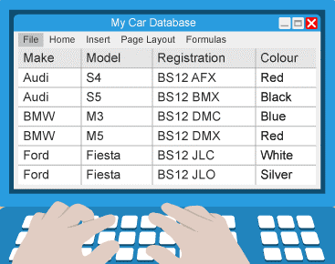
Key Field/Primary Key
In order to produce a logical structure for your database, there should be something unique about each record.
This will normally be the contents of one particular field, called the key field.
For example, if you had a car database, then you could use the registration number as the primary key, as no two cars should have the same one.

Slide 10
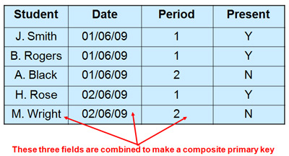
Compound Key
Sometimes you can't identify a single key field in your database table.
In cases such as this, you can create what is known as a compound key - a combination of fields that makes a record unique.
This can be any number of fields, but should be the minimum number required to produced a unique description of the record.

Slide 11
Foreign Key
A primary key in one table which is used as a foreign key in another table to provide a link between the tables.
A foreign key in one table is always linked to a key field in another table.
A foreign key does not have to contain a unique value in its table, as it does in the primary table

Slide 12
Secondary Keys/ Indexes
A secondary key is made on a field that you would like to be indexed for faster searches.
When databases become large, they can take a while to search.
They can be set up so that it can be searched more efficiently - fields that are likely to be searched upon can be indexed for faster searching (like the index at the back of a book)
Secondary keys:
May not be unique
Are used for sorting or searching data

Slide 13
Advantages of a relational database
Data is only stored once – this avoids data duplication and means that data is only stored once.
Data integrity is maintained
Easy to modify the format
Security is better as sections of the data can be protected individually using authorisation
More “future proof” as it is easier to update and expand the basic structure than a flat file.
More complex queries can be run over the data
Disadvantages
Difficult to set up

Slide 14
Flat File Database
Consider the following flat file database:
What are the potential problems?
ID | Forename | Surname | Telephone Number | Street | Town | Postcode | Pet Name | Pet Breed | Problem
2 | Jonathan | Grimes | 01562 856 965 | 657 Abbey Road | Dublin | DB87HB | Trevor | Stick Insect | Monthly checkup
5 | Edward | Grimes | 01562 856 965 | 675 Abbey Road | Dublin | DB87HB | Dave | Lizard | missing tail
2 | Jonathan | Grimes | 01562 856 965 | 657 Abbey Road | Dublin | DB87HB | Trevor | Stick Insect | Monthly checkup
2 | Jonathan | Grimes | 01562 856 965 | 657 Abbey Road | Dublin | DB87HB | Trevor | Stick Insect | Monthly checkup
3 | John | Sexton | 01495 333 000 | Lime Avenue | Ebbw Vale | NP676TF | Gnasher | Bulldog | sore paw
2 | Bob | Collier | 01495 333 000 | Lime Avenue | Ebbw Vale | NP676TF | Rudolph | Reindeer | red nose
1 | David | Cameron | 0208 9546 321 | 10 Downing Street | London | W15FT | Nick | Puppy | Bad breath

Slide 15
Relational Databases
To overcome the problems of flat file databases, relational databases were developed.
Data is split over several tables which are linked (related) to other tables.
The process of organising data in this way is called normalisation

Slide 16
Relational Databases
In the previous flat file database we noted several problems which could have been avoided if the data had been normalised e.g.

Slide 17
Data Integrity
Data integrity refers to the correctness of the data over the lifetime of that data.
This means that the data is correct when it enters the database, as it is queried and updated up until the point it is removed from the system.
Data must be complete, accurate and consistent.

Slide 18
Data Integrity
There are three main types of integrity:
Entity integrity – every table must have a primary key which is unique and not empty
Referential integrity – foreign keys must point to the primary key of another table but can be empty (meaning that there is no relationship)
Domain integrity – all attributes in the database are related to the overall domain that the database is working on.

Slide 19
Data redundancy
This refers to the unnecessary duplication of data.
In a flat-file database details about information such as artists will be duplicated.

Slide 20
Data Consistency
When data is held in more than one file it should be stored in a consistent way.
A date field could be stored as a text field in one table but as a date/time field in another, meaning the data would be incompatible.
In a relational database because the attributes of any one entity are contained within one table, there is no risk of it being stored in a different format in a different file

Slide 21
Data Independence
This refers to the separation of the data from the programs that use it.
This means that users can view data without having to be aware of the basic structure of the database, and allows them to manipulate it in many different ways.
User can also not make changes to the underlying structure of the database.

Slide 22
Flat File v Relational Databases
May have redundant data, which increases the overall size of the database and reduces data integrity | Data integrity is maintained
Harder to update the database design | Easier to update the database design
No specialist knowledge needed to set one up | Provides security features e.g. individual tables can be protected
 | Need specialist knowledge to set up and maintain

